Slide 1

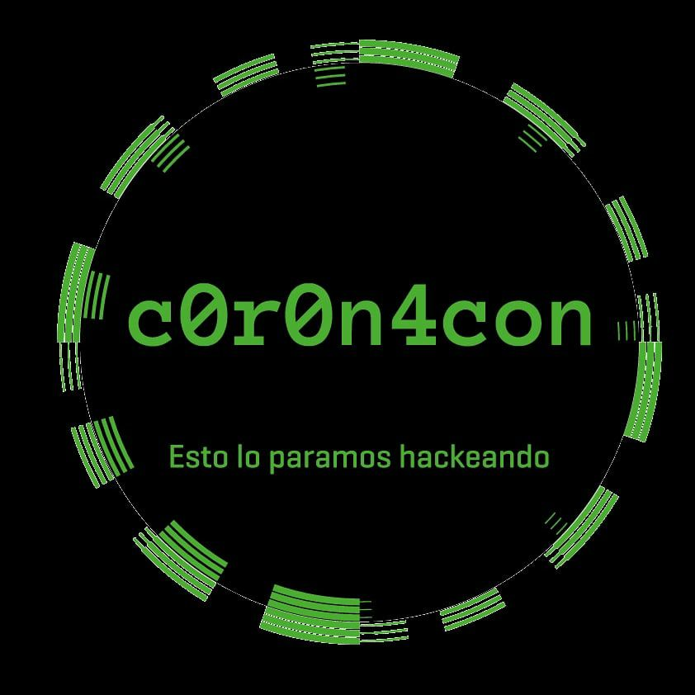

evil mass storage
David Reguera Garcia aka Dreg
2020

Slide 2

David Reguera Garcia aka Dreg
Senior malware researcher, C, C++, ASM, x86_64, ARM Cortex & AVR
Contributing to rootkit unhooker, unhide, x64dbg, enyelkm, anticuckoo, dbgchild....
https://github.com/David-Reguera-Garcia-Dreg/evilmass_at90usbkey2
https://twitter.com/fr33project
http://www.fr33project.org/
dreg@fr33project.org

Slide 3
evil mass storage – POC just for fun
infect a target machine without NET & exfiltrate info
hardware: at90usb1287 + atmega328p + ts3usb221 + mosfet + sd card reader (SPI) + rf 433MHz ASK …
multi-stage malware: only visible when connected to target
exfiltrate info via two ways:
mass storage: crypt & hidden sectors
radio: rf 433MHz ASK
firmware: keyboard + mass storage (USB composite device). LUFA + FatFs + Dreg adaptation “USB Mass storage SD card for Teensy2/ATMEGA32U4 by Mathieu Sonet”
dynamic: serial, VID, PID, USB Descriptor, decrypt/delete sectors…

Slide 4
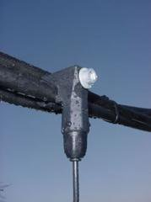
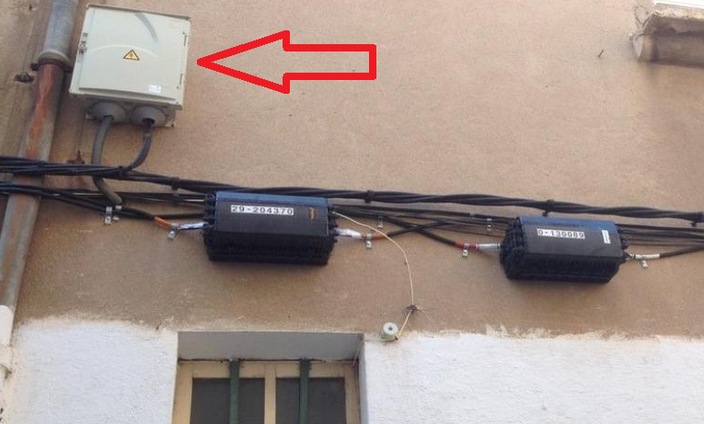
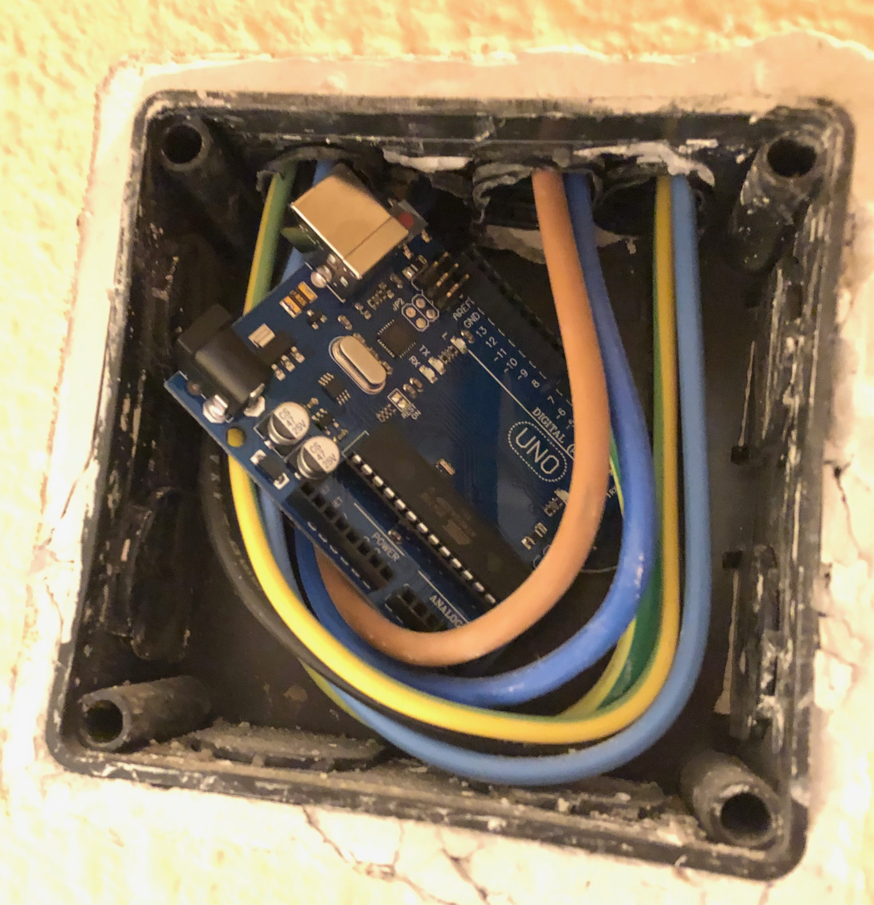
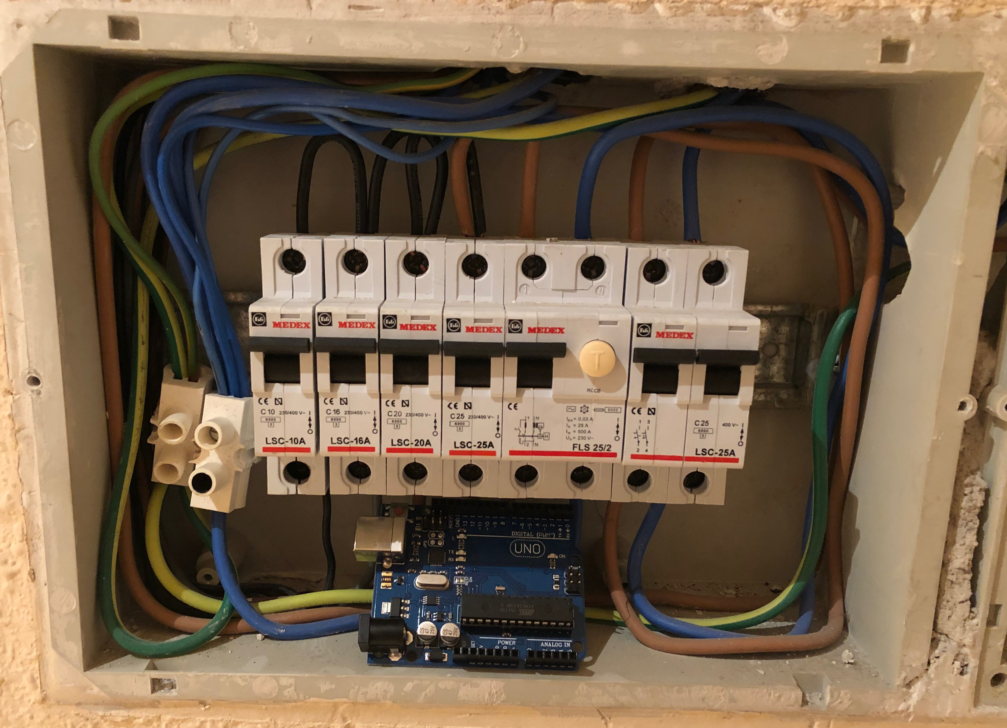
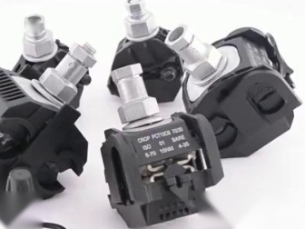
external hardware - receiving data
rf 433mhz receiver
WIFI AP/STA
SMS
GSM/GPRS
MICRO SD CARD

Slide 5
demo prototype evil mass storage

Slide 6
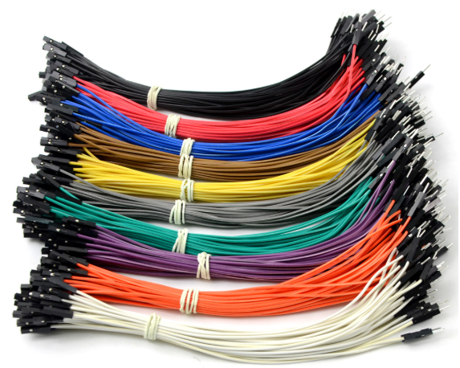
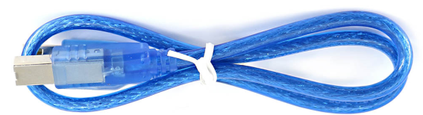
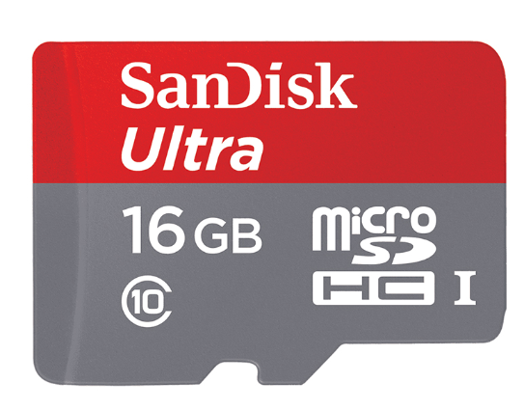
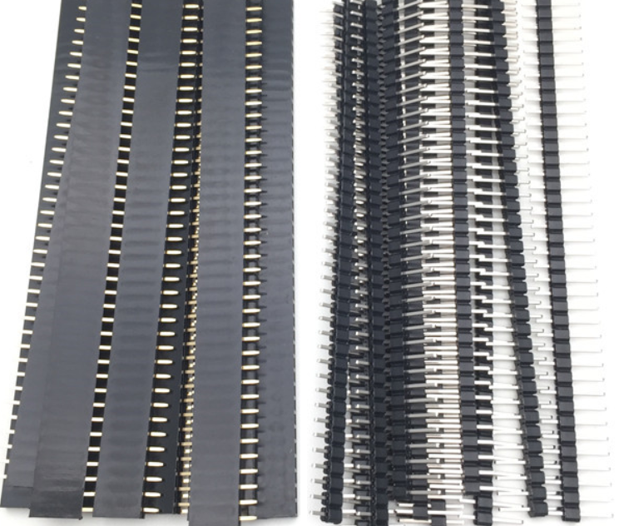
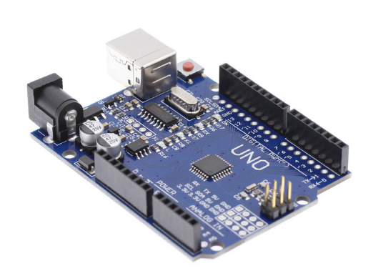
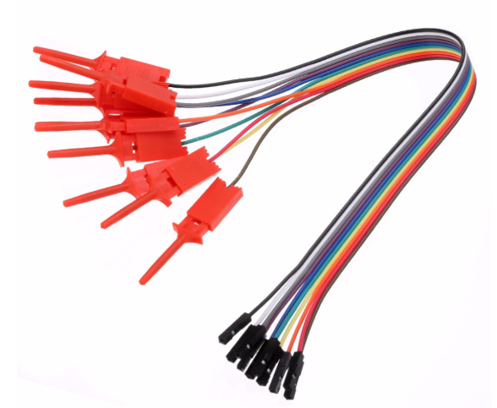
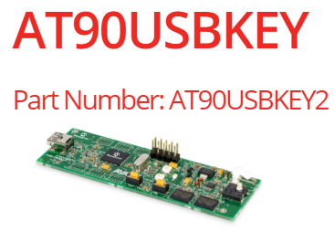
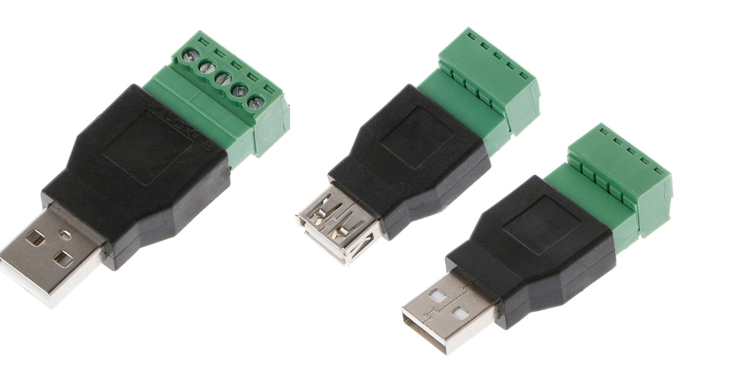
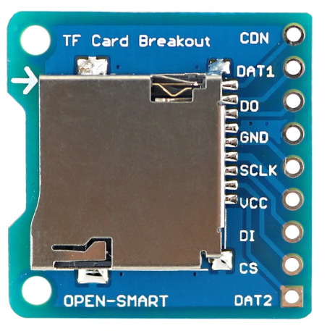
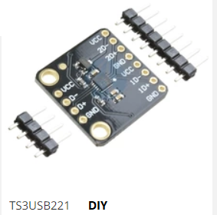
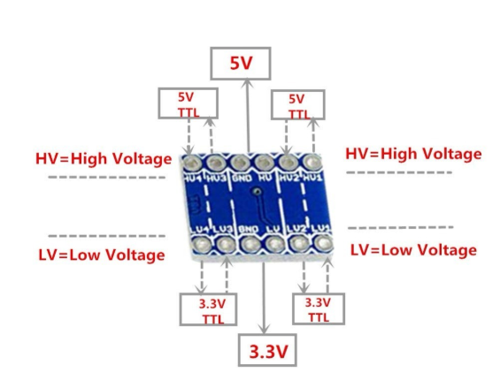
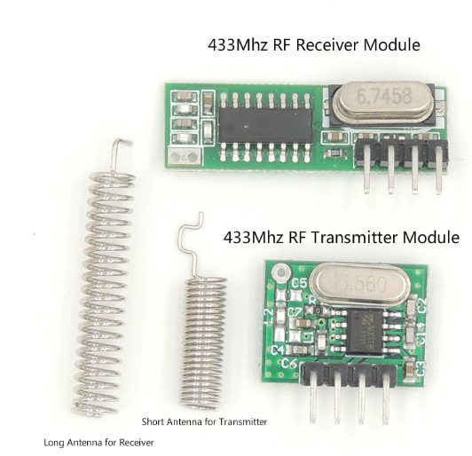
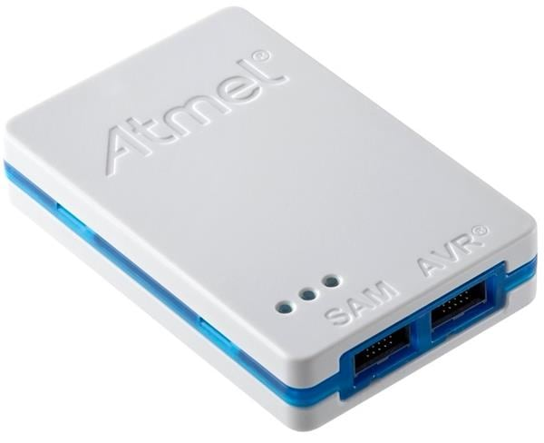
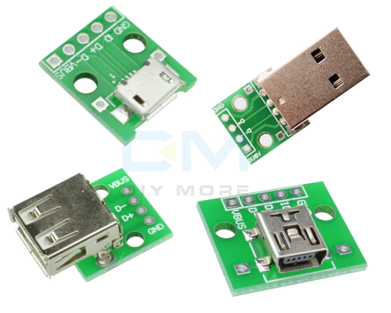

Slide 7
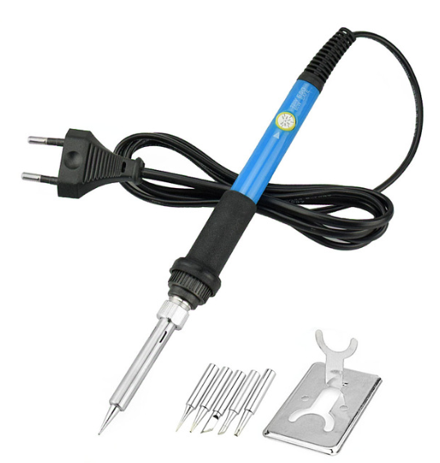
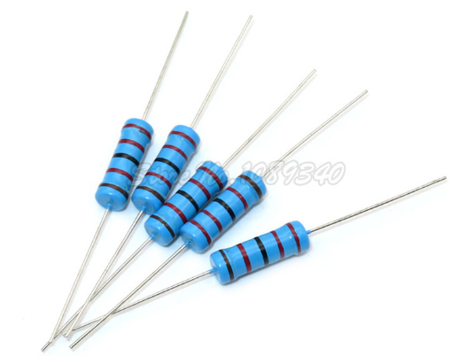
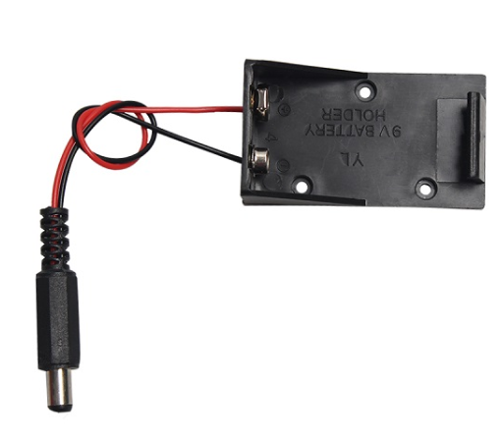
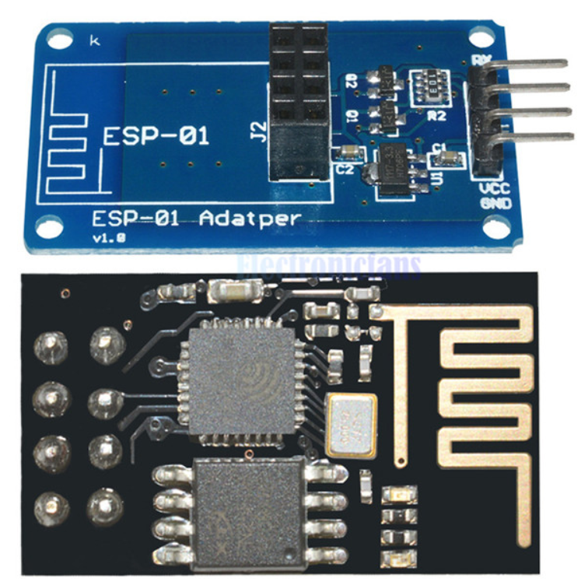
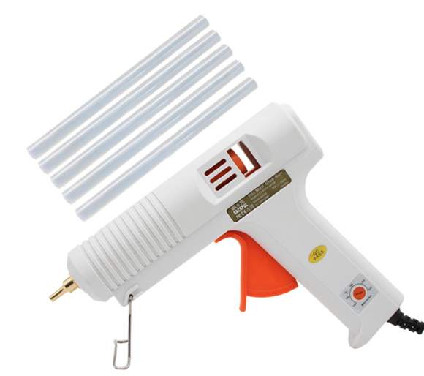
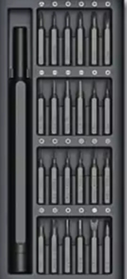
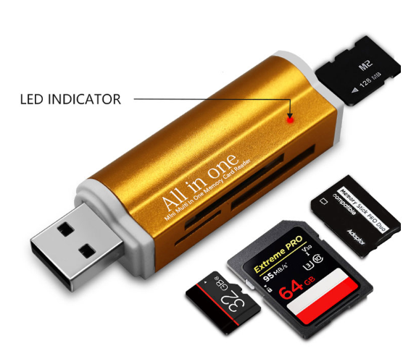
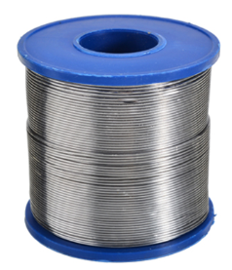

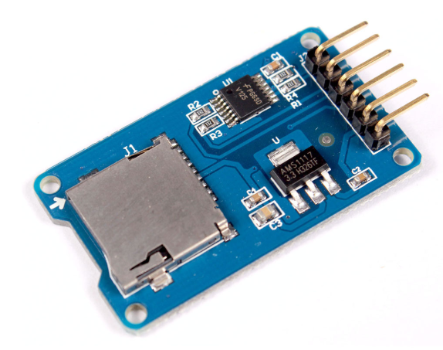
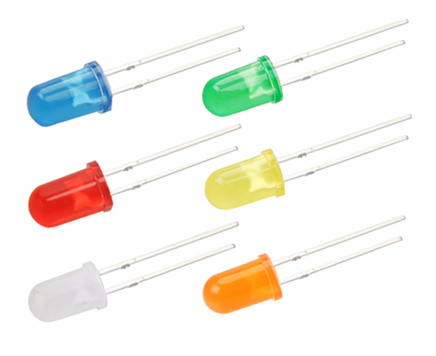
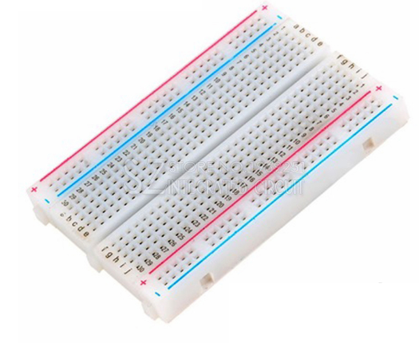
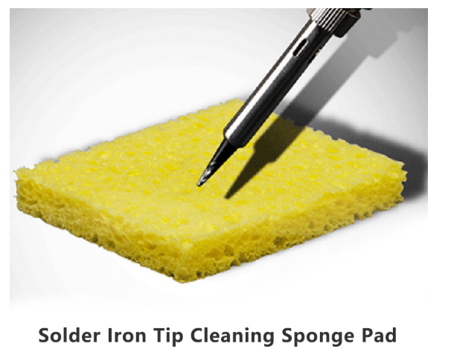
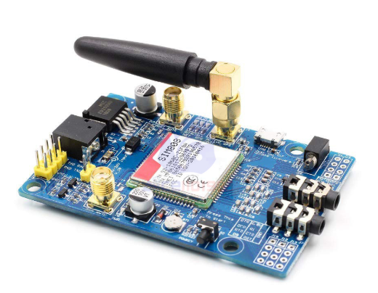
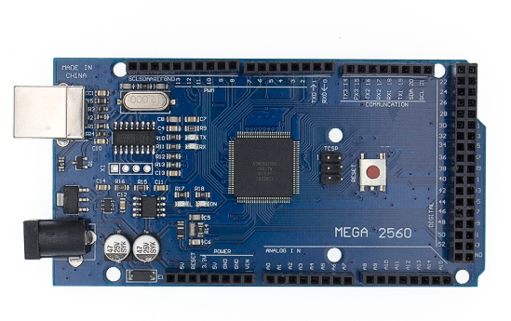
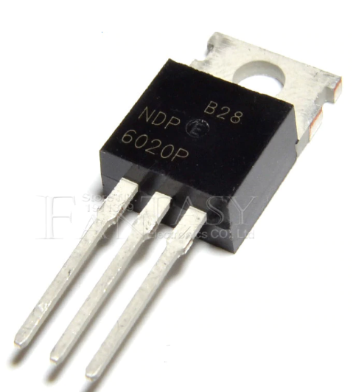
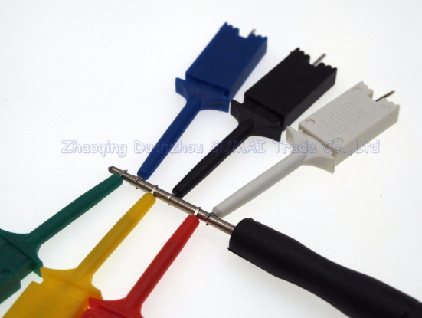

Slide 8
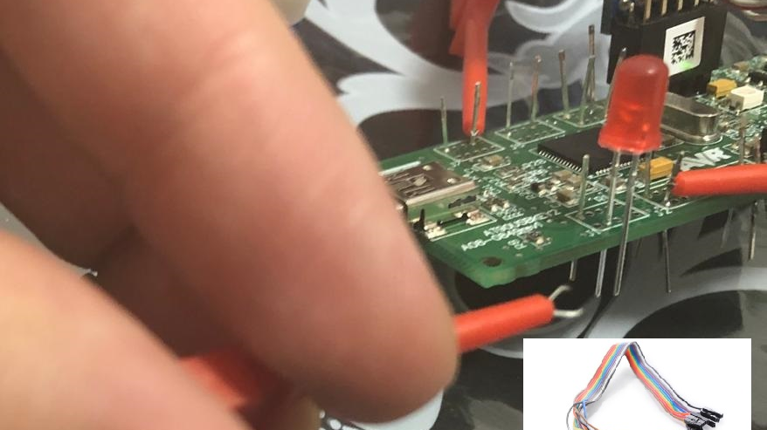

Slide 9
prototype shopping list 1
mini soldering iron + iron tip
arduino uno + cable
arduino mega 2560 + cable
USB 2.0 Type A 1-Male 1-Female to 5P Screw with/ Shield Terminal Plug Adapter Connector
USB to DIP Type A 2-Female 1-Male USB Adapter Converter for 2.54mm PCB Board DIY
ESP-01S ESP8266 Serial Wi-Fi Wireless Module + ESP-01 Adapter for Arduino (5v)
400 Tie Points Solderless PCB Breadboard Mini Universal Test Protoboard DIY Bread Board Bus (x2)

Slide 10
prototype shopping list 2
4 Channel 5V 3.3V IIC UART SPI TTL Logic Level Converter level conversion module
10pcs High Efficiency Test Hook Clip Logic Analyzer Cable Gripper Probe Test Clamp Kit
kit LEDs 5mm Red Blue Green Yellow White
mosfet NDP6020P TO-220 NDP6020 TO220 6020P P-channel
433 Mhz RF Receiver and Transmitter Module. RX470-4, WL102-341, Short antenna for Transmitter. Long antenna for Receiver
common values resistor Kit
DIY TS3USB221 High-Speed USB 2.0 (480Mbps) 1:2 Multiplexer To Demultiplexer Switch With Single Enable Board Module

Slide 11
prototype shopping list 3
Reader Adapter for Micro SD USB 2.0 TF M2 MMC MS PRO DUO Card Reader
2PCS 9V rechargeable battery large capacity 1000mAh lithium ion rechargeable battery + 1PCS smart 9 V charger
9V PP3 Battery Holder Box Case Wire Lead ON/OFF Switch Cover with DC 2.1mm Plug
SanDisk micro SD card 16GB SDHC + adapter
DC 9V1A 9V 1A Power Supply AC 100V-240V Converter Adapter Plug Charger 5.5mm x 2.1mm 1000mA
SIM808 module GSM GPRS GPS Development Board IPX SMA with GPS Antenna

Slide 12
prototype shopping list 4
Screw Kit Screw Driver
Micro SD / TF Card Breakout to DIP Board Module (3.3v)
Micro SD Module TF Micro SD Storage Board TF Card Memory Shield (5v)
120pcs 40PIN 20CM Dupont Line Male to Male, Female to Male, Female to Female Jumper Dupont Wire Cable
AT90USBKEY2
ATMEL ICE (ATATMEL-ICE)
solder iron tip cleaning sponge pad
Tin Lead Rosin Core Solder Wire

Slide 13
prototype shopping list 5
Hot Air Glue Gun Thermo Electric Heat Temperature
Test hook clip,Grabber SMD IC Test Probe Hook for Multimeter,Logic analyzer…
20pcs 10 pairs 40 Pin 1x40 Single Row Male and Female 2.54 Breakable Pin Header PCB

Slide 14
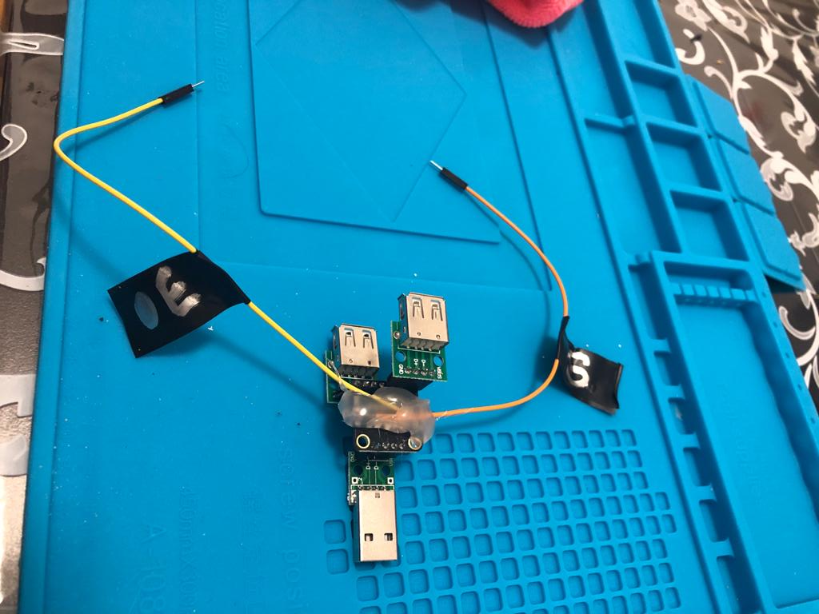

Slide 15
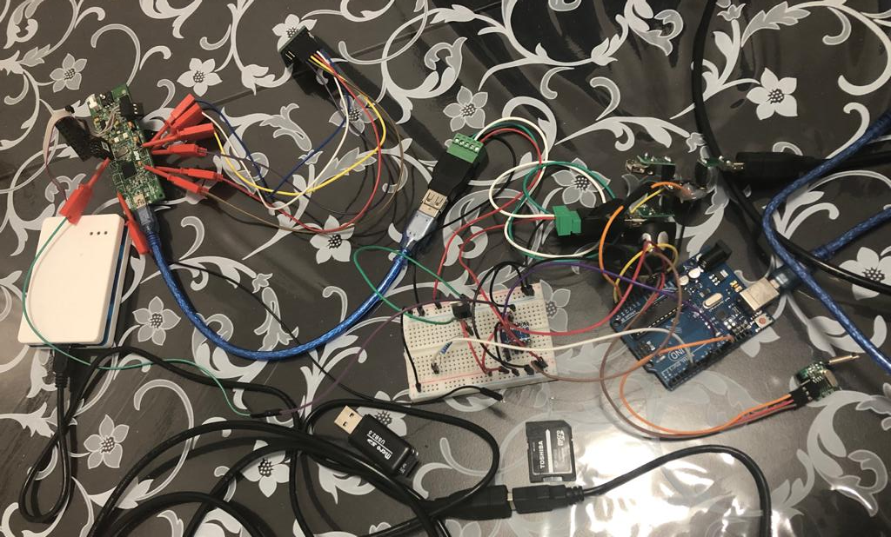

Slide 16
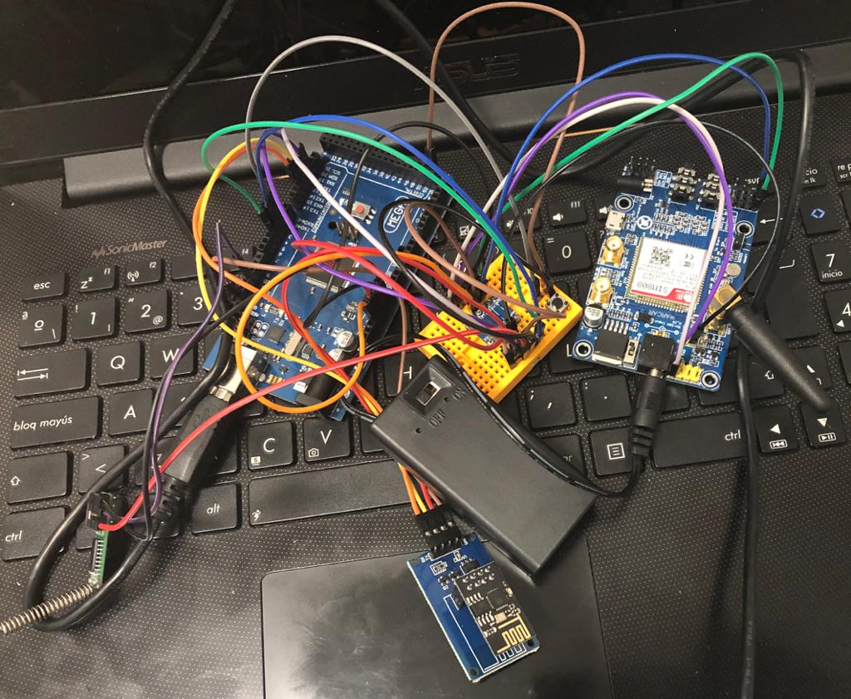

Slide 17
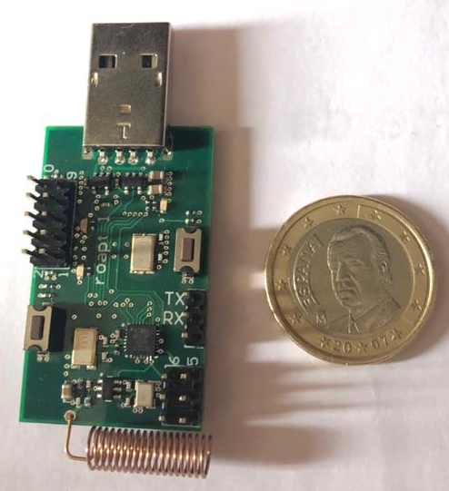
Roapt – my own pcb for attack
soon available at https://www.rootkit.es
JTAG, ICSP, UART…
current beta prototype 1.0

Slide 18
SD card SDHC 16GB
special mass storage
2GB FAT16
f.exe
g
FAT16, Only 1 FAT TABLE. SPI is slow
f.exe: malware crypted – multi-stage
exfiltrate blocks crypted from .exe
g: file for communication with firmware. firmware can encrypt/decrypt sectors, relocate writes & reads, reset USB connection (OS cache), change stages, delete all f.exe entries..
special area is “protected”
Its possible switch between special-normal
normal area can be formatted
normal mass storage
2GB FAT16
f.exe
g
f.exe
stage1
f.exe
stage2
…
exfiltrate area

Slide 19
demo create & burn SD card image

Slide 20
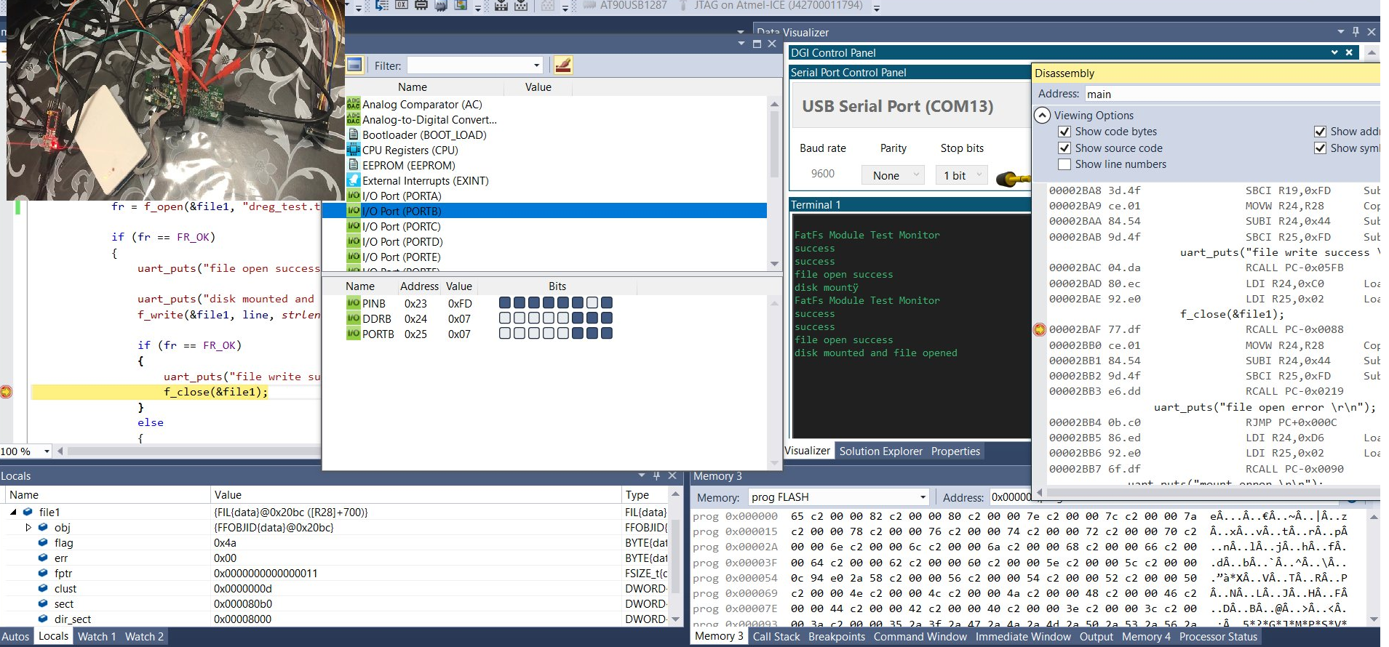
demo firmware: dev, debug & flash. Atmel studio 7

Slide 21


USB Mass Storage: Designing and Programming Devices and Embedded Hosts
USB Complete: The Developer's Guide (Complete Guides series)
https://www.microchip.com/DevelopmentTools/ProductDetails/PartNO/AT90USBKEY2
https://www.microchip.com/wwwproducts/en/AT90USB1287
https://www.avrfreaks.net/
http://elm-chan.org/fsw/ff/00index_e.html
http://www.fourwalledcubicle.com/LUFA.php

Slide 22
TO-DO
improve source code: leaks, overflows, crap code…
improve performance: fatfs, ISRs…
more firmware & examples: SharpLocker/LockScream...
more doc
OS X & Linux examples
more keyboard langs (current English)
support multi-file (current POC is limited)
exf mode selection: 433MHz(slow) or mass storage(faster)

Slide 23
Future (maybe)
ARM Cortex-M4 180MHz 32 bit + rf transceiver
NXP Kinetis MK66FN2M0VMD18 or MK66FX1M0VMD18
native 4bit-SDIO micro sd card port (SPI is very slow)
cryptographic acceleration unit (AES) & CRC
random number generator
https://www.pjrc.com/store/teensy36.html
NXP Kinetis FRDM-K66F board
https://www.utasker.com/kinetis/FRDM-K66F.html

Slide 24
Greetz & credits
janio IRC-HISPANO
Sergio Lara & Luis Fernando Regel – Panda
Jose Vicente Martínez – electronic engineering
Paul Stoffregen - pjrc, teensy, altsoftserial…
Mathieu Sonet: mass storage SD for Teensy2/ATMEGA32U4
Dean Camera: lufa
ChaN: fatfs
Yassin Said Esteller
avrfreaks.net

Slide 25
Thx! Questions? evil mass storage in my github
https://www.rootkit.es
https://github.com/David-Reguera-Garcia-Dreg/evilmass_at90usbkey2
https://twitter.com/fr33project
http://www.fr33project.org/
dreg@fr33project.org

Slide 26


https://c0r0n4con.com/ https://www.cruzroja.es/webCre/donativos/donativos.php?llamada=2.9.193.13860.24/05/04.2.13860

